Slide 1
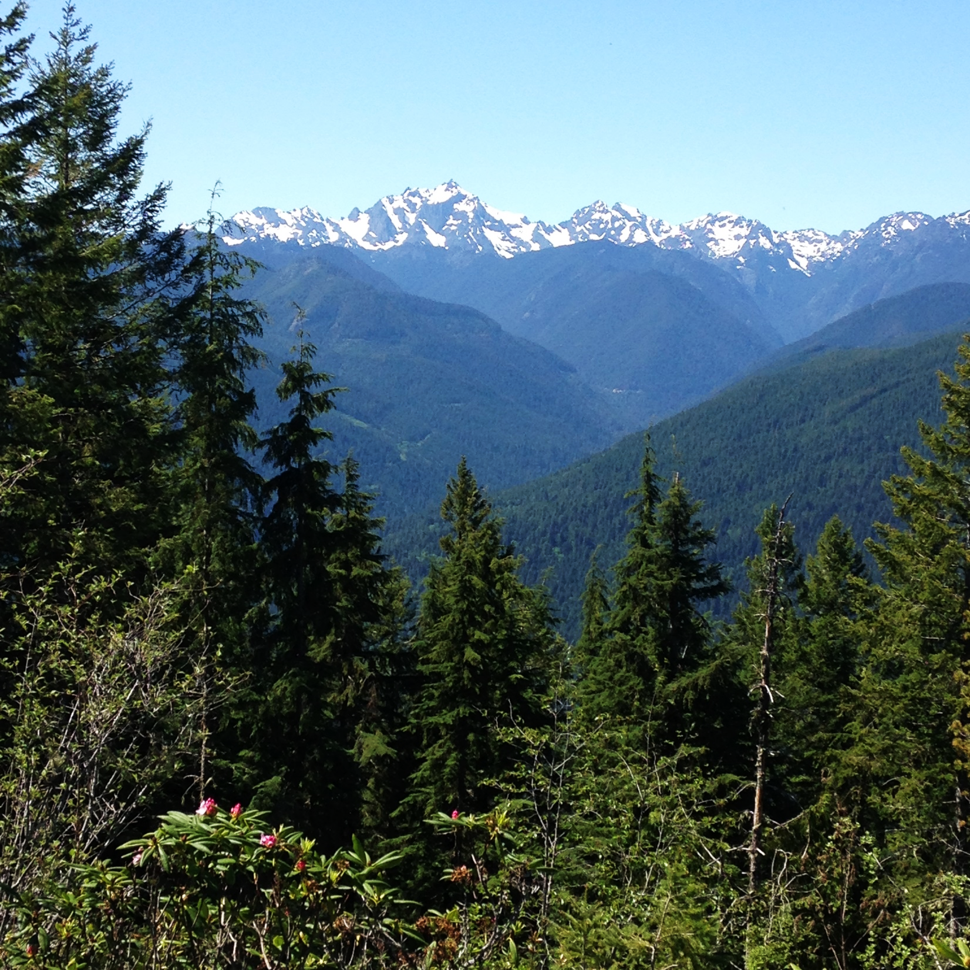

The Douglas-fir Seed-Source Movement Trial
Project leads:
Connie Harrington, Brad St. Clair
PNW Research Station
July 26, 2019
Notes:
It consists of vegetative and reproductive phenology measurements (day of year of budburst), height growth, and diameter growth for Douglas-fir trees growing at several different sites over ~ 10 years (depending on the site). There is also data on survival of trees over the time period. Here's more info on the project the data are from: https://www.fs.usda.gov/pnw/projects/douglas-fir-seed-source-movement-trial
These measurements can be paired with temperature and precipitation data from onsite weather stations (hourly observations even - although I'm guessing that's a bit much)..... Perhaps students could predict either the timing of phenology, growth, or survival in the near future based on phenology and growth responses to past climate conditions? Do you think that would be of interest? Let me know if you want to chat about this - I'm probably not doing the best job describing the data, but we'd be happy to have some new eyes check out!
The raw data are yearly height, diameter, and basal diameter measurements taken at the end of the growing season for approx. 900 trees from different seed sources at each of 9 sites across Oregon and Washington over 9 years. We can reduce the dataset to something that seems manageable for the class.

Slide 2
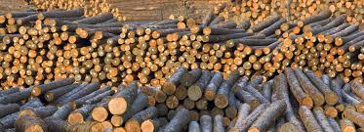
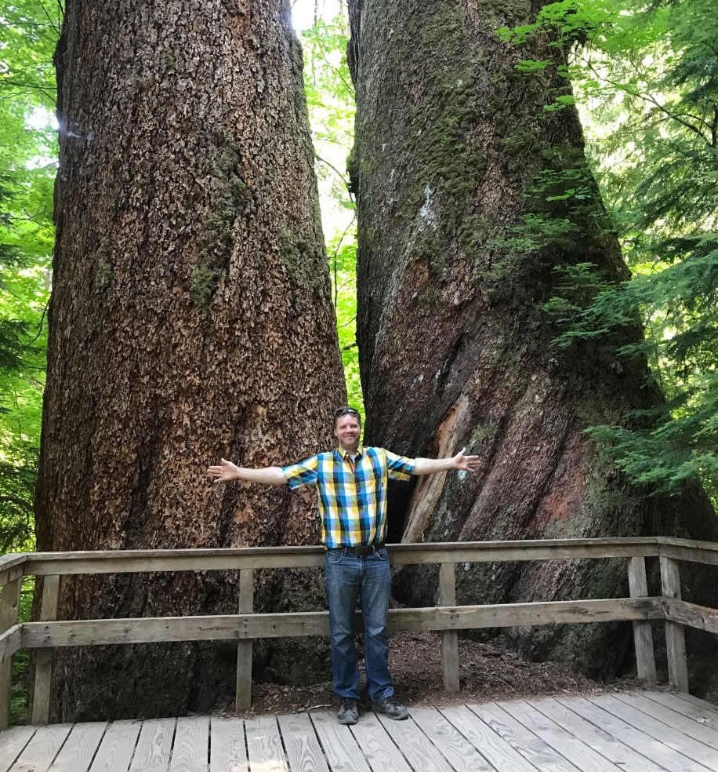
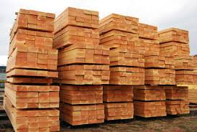
Why Douglas-fir?
Ecological & Economic King in western WA and OR
Great Western Lumber
Spi-ind.com

Slide 3
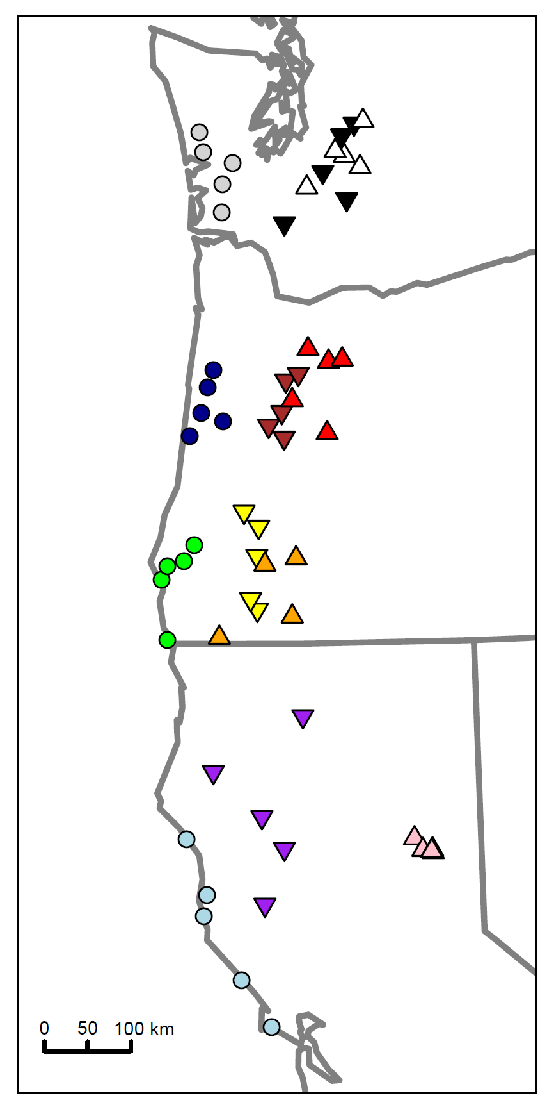
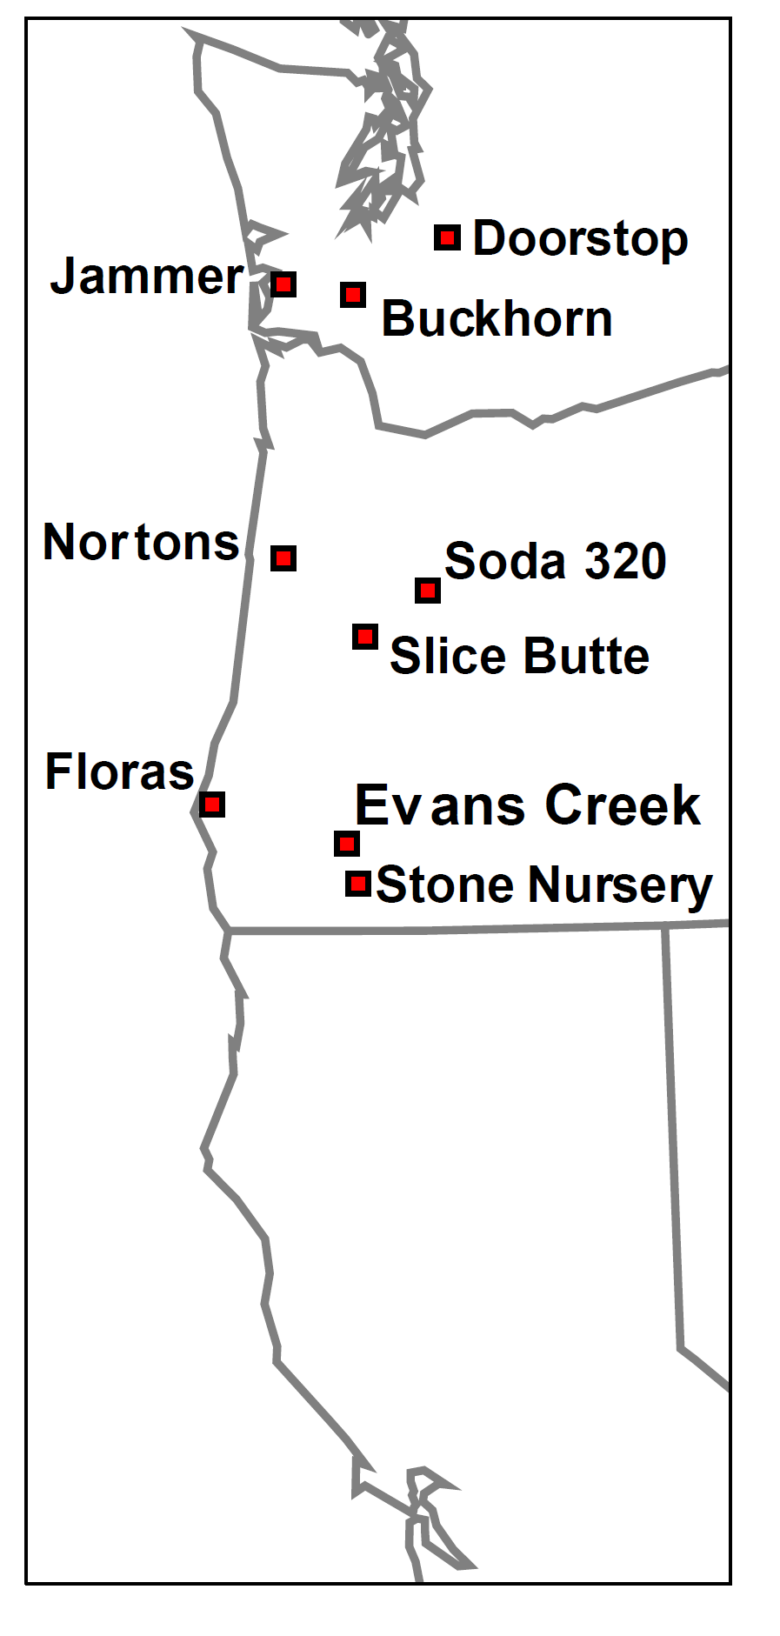
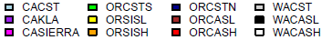
Seed Collections
Outplanting sites
Locations where seed was collected – 12 Regions;
5 locations per region, 2 trees per location = 120 families
Douglas-fir hasn’t had long-term trials with populations that represent wide range of climates
Notes:
Colors on map on the left refer to our regions (study used seed from 12 regions). We had 5 locations in a region and 2 trees per location (so 120 families in all). The trees in the field have a large ring to indicate the region and a small ring to indicate the family.

Slide 4
Seed Collections
Outplanting sites
Notes:
Colors on map on the left refer to our regions (study used seed from 12 regions). We had 5 locations in a region and 2 trees per location (so 120 families in all). The trees in the field have a large ring to indicate the region and a small ring to indicate the family.

Slide 5
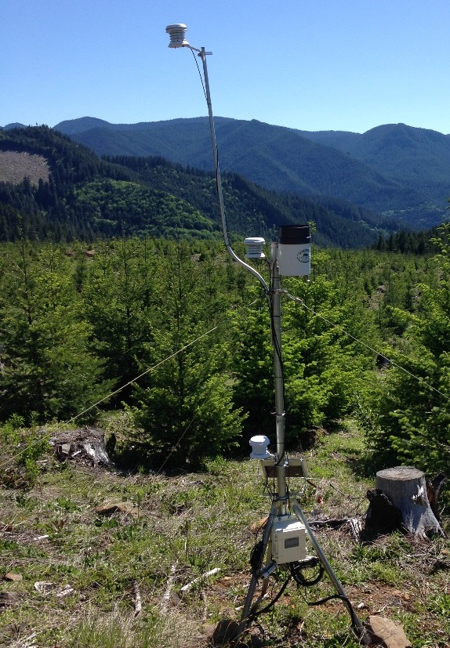
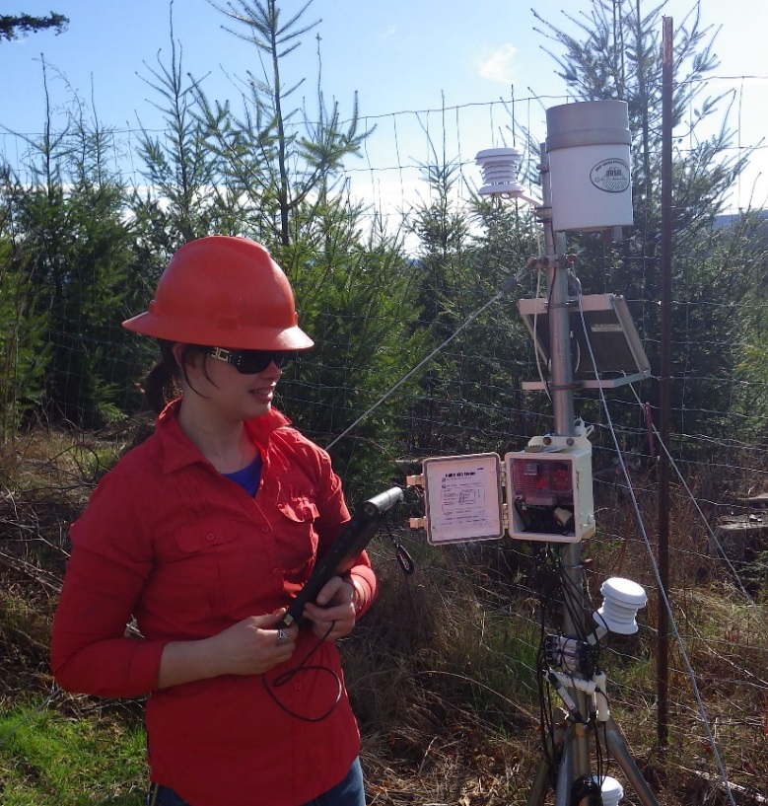
SSMT data collected 2009-2019
Tree height, diameter, survival, condition (all study trees, all years)
Timing of spring budburst (all study trees - few years, more trees - fewer years)
Timing of diameter growth using dendrometers (3 regions/3 sites, multiple years)
Timing of height growth (some sites and years, used time lapse cameras 1 year)
Foliage diseases (all study trees, all sites, 1 year)
Air temperature, soil temperature, precipitation, etc.
Hobo weather stations at Seed Source Movement Trail sites

Slide 6
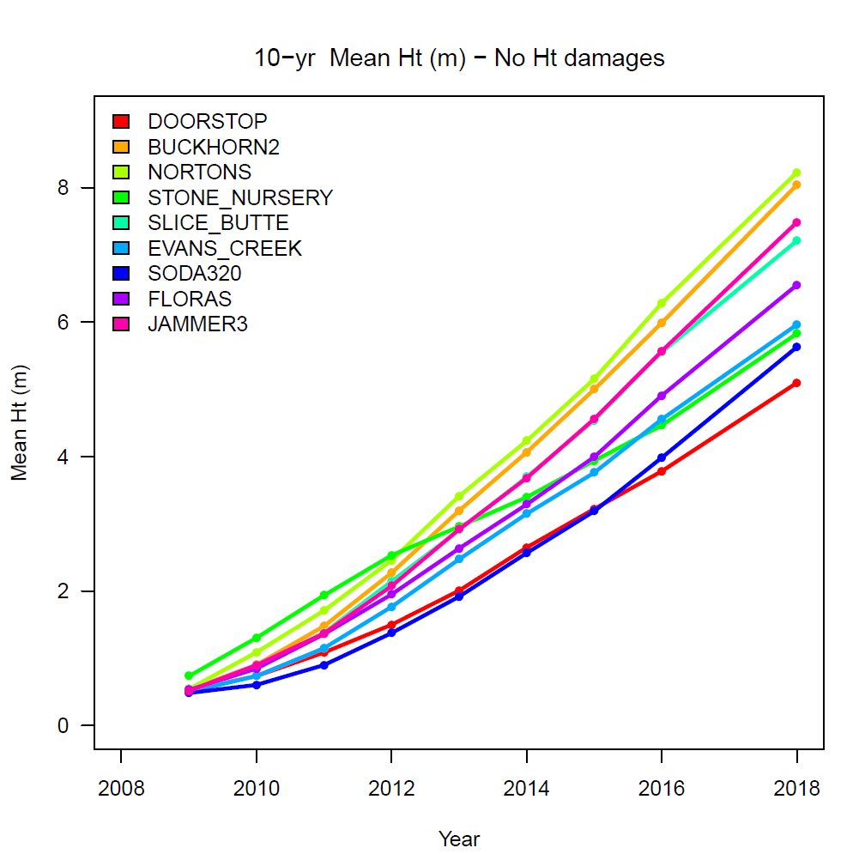
Planted Fall 2008/Spring 2009

Slide 7
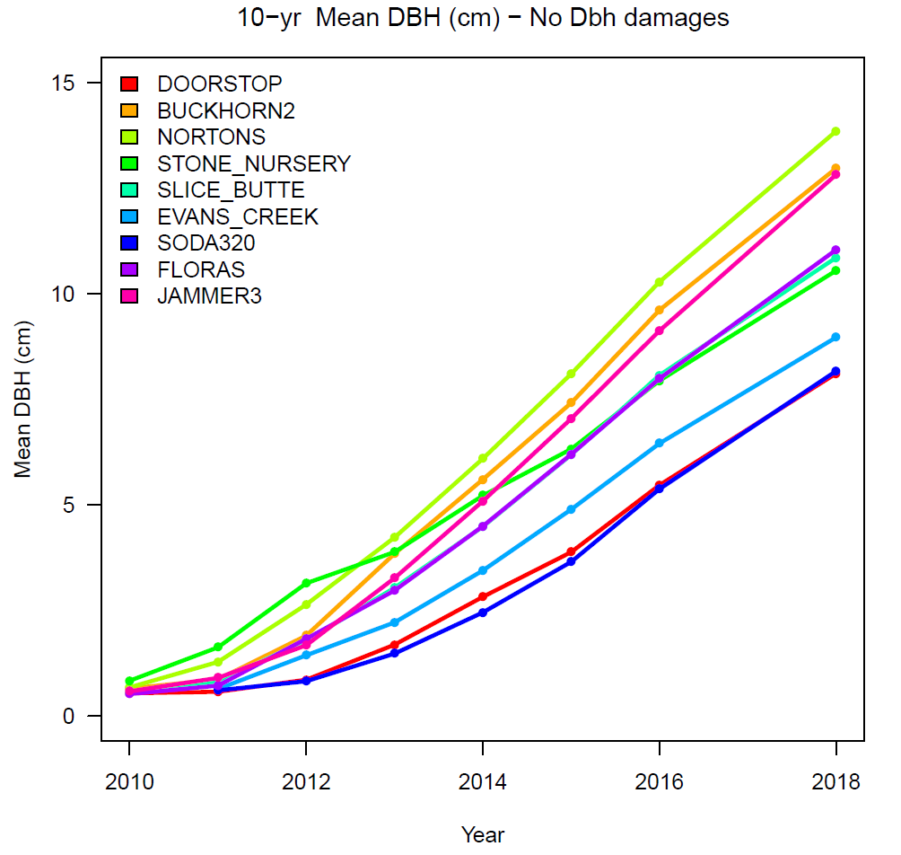
Planted Fall 2008 or spring 2009
Metric Hint
7.5 cm ~ 3 in

Slide 8
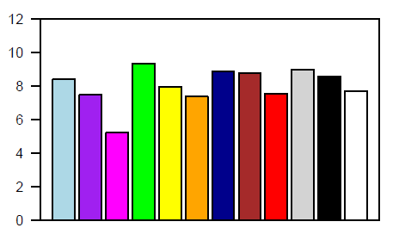
Buckhorn2
10−yr Mean Height (m) − No Ht damages

Slide 9
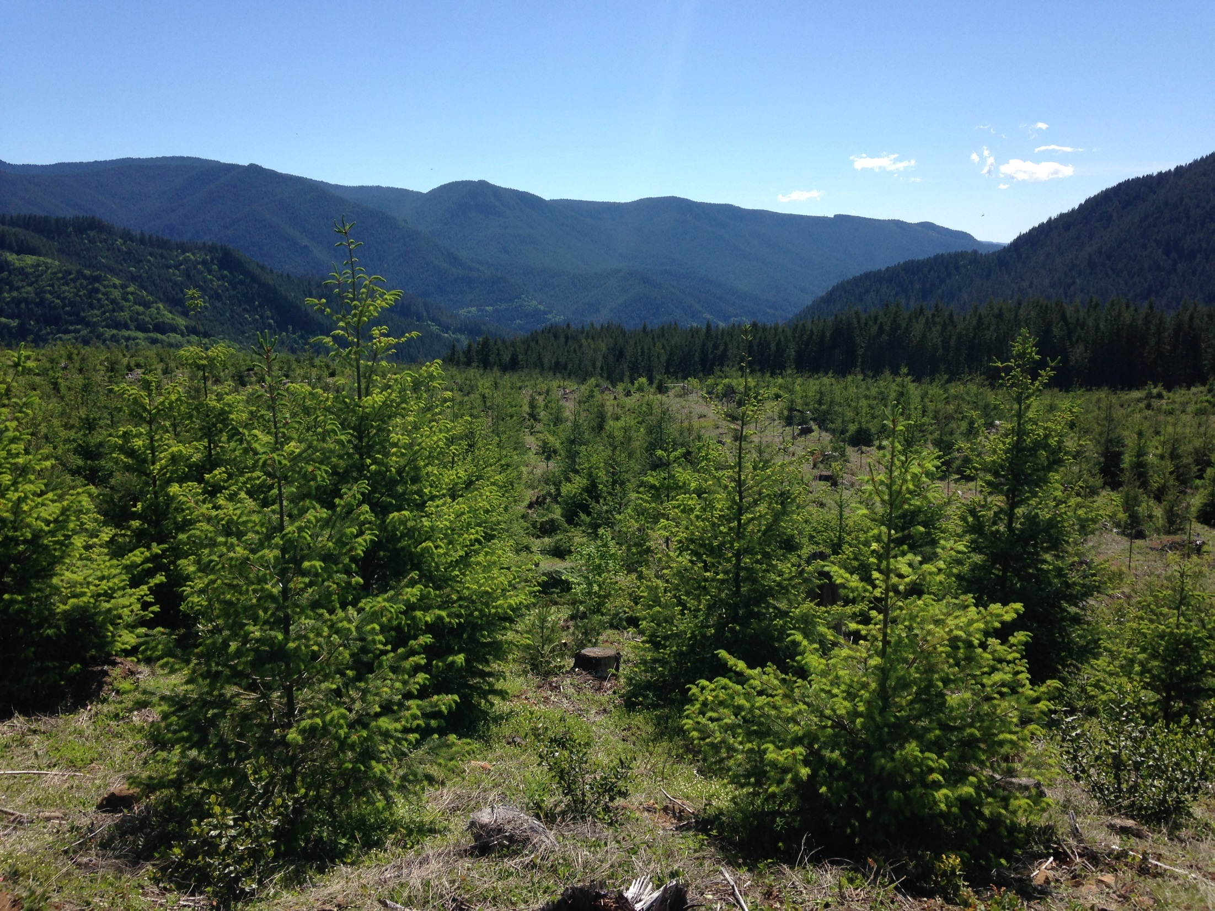
Can we predict yearly height or diameter growth based on temperature, precipitation, and seed source?

Slide 10
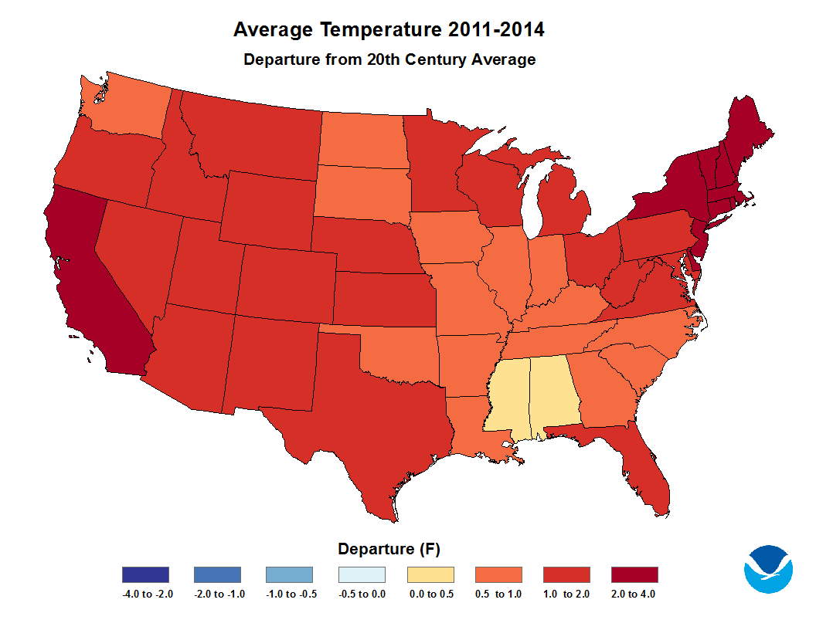
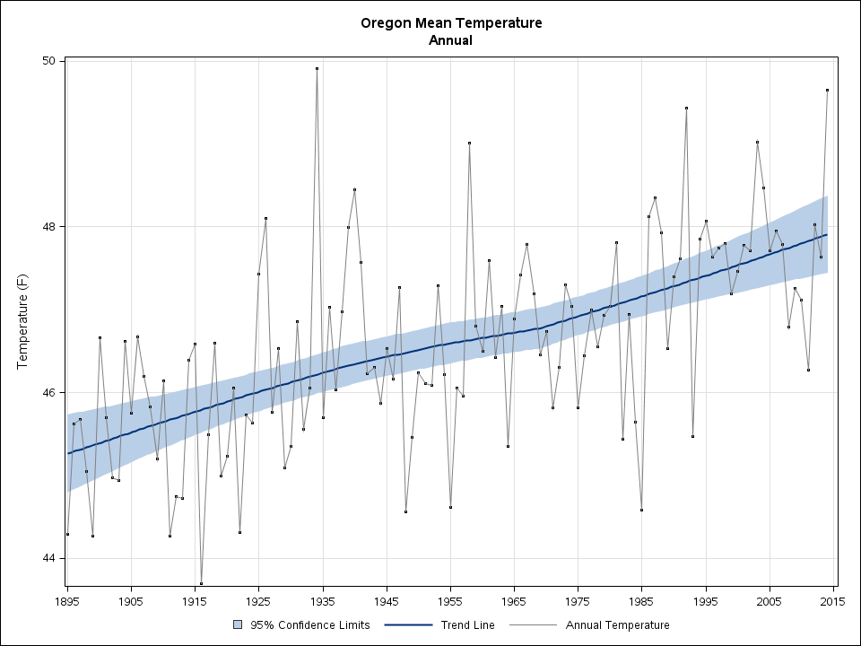
Importance
Managers want to accurately predict timber growth and yield over shorter as well as longer timeframes
Understanding the environmental and genetic cues that affect growth will help us predict changes, and manage for more desirable/adaptable trees in the future
Notes:
If the models for M/F are not the same, then there is an opportunity for the processes of pollination and receptivity to get out of synch - this can be managed in SO when doing controlled crosses – but can be an issue if relying on mass pollination in an orchard or in seed production areas or in natural stands Note – we do NOT think this is currently occuring, but would like to collect data to verify and monitor this
Additionally – if there are chilling requirements for flowering that aren’t met – if , and winters get warm enough that these are not met – it is possible that the trend of early flowering in warmer springs may be reversed – and it is important for us to know that ahead of time…. flowering can be delayed with expensive warming…

Slide 11
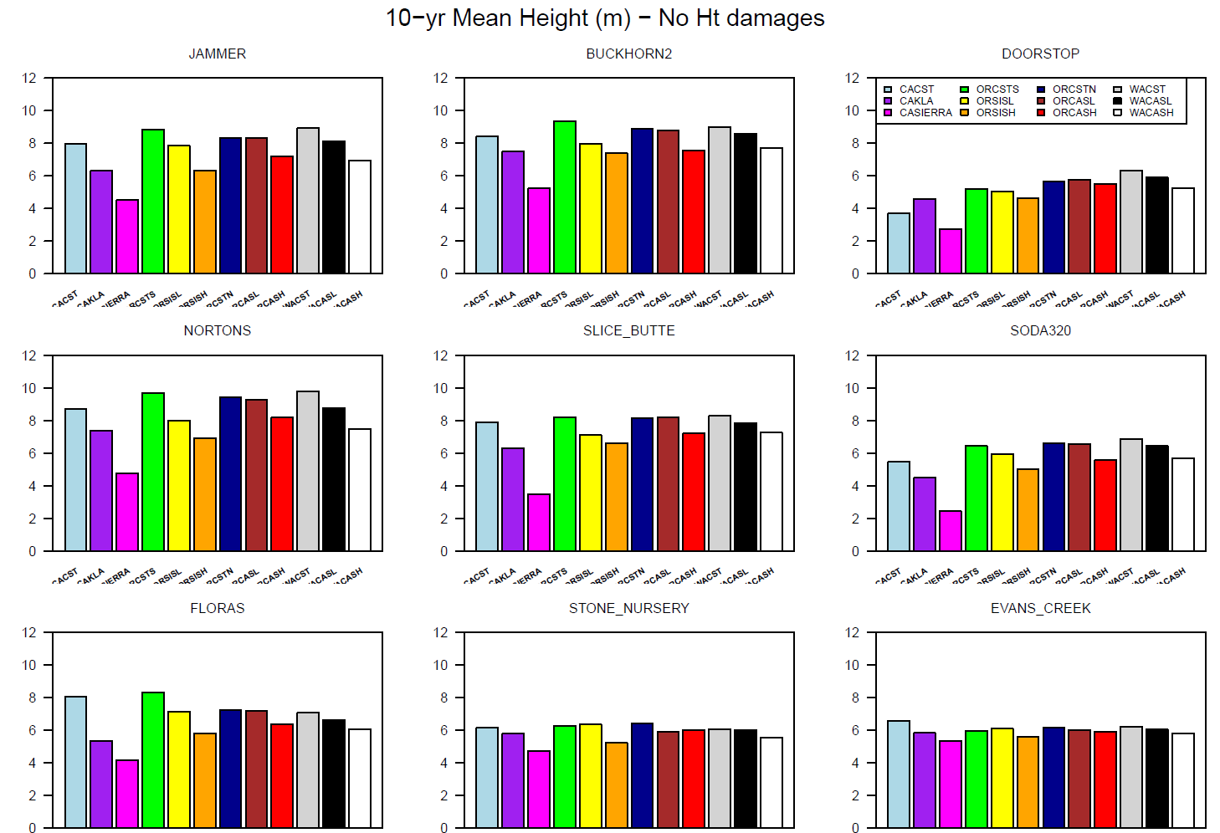
Metric hint 5 m = 16.4 ft, 8 m = 26.2 ft

Slide 12
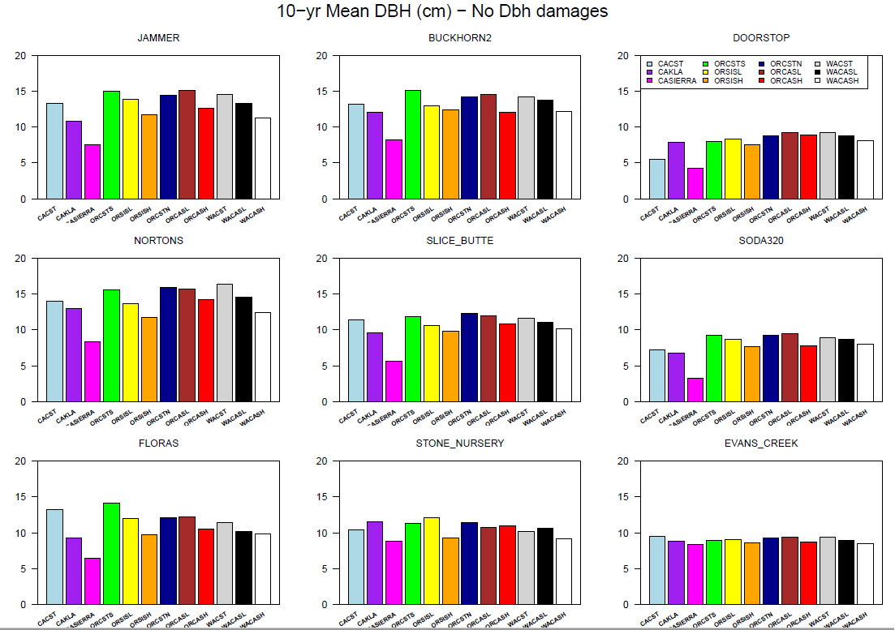
Metric Hint 10 cm ~ 4 in

Slide 13
Year 8 Growth Modeling
Evaluated using Universal Response Function (URF) approach (Wang et al. 2010)
Growth modeled as a function of climate of the seed source (where it evolved) and the climate of the test site (where it is growing)
The single best variable (highest R²) for the seed source climate was continentality (summer minus winter temperature)
The single best variable (highest R²) for the test site climate was climate moisture deficit (measure of aridity)
Notes:
Other climate variables are correlated with these two variables; really results are a function of a multivariate climate, but we without a lot of test sites, we are limited in the number of variables we can put into the model.

Slide 14
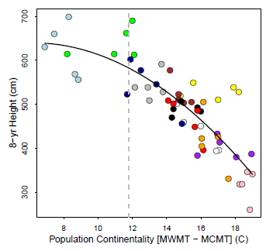
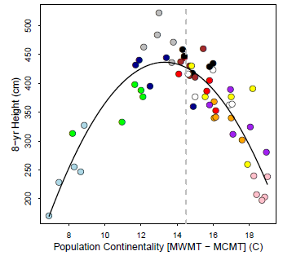
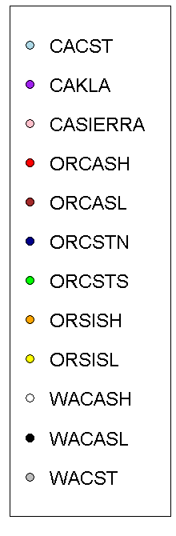
8-year height at Floras and Doorstop as a function of seed source continentality
Floras
Doorstop
Dotted line indicates continentality at each test site (i.e. local climate); movement away from line indicates response from moving populations away from local climate (i.e., transfer function)
Notes:
At the southern Oregon coastal test site:
Best growth comes from CA and Southern Oregon coast populations
Slower growth from the high, dry, cold sites in the CA Sierras and Klamath mountains.
Local is best (ORCSTS), but also good growth from slightly less TD.
At the high elevation WA Cascades site:
Good growth from higher elevation Cascade sources, but also WA and OR Coast.
Dotted line represents the TD at Doorstop.
Local is not quite the best at this time, but they are close. Better sources come from somewhat warmer sites coastal sites.
This is 6-year height after planting (8 years from seed). The axis labels that say 7-yr height iare wrong!

